Slide 1
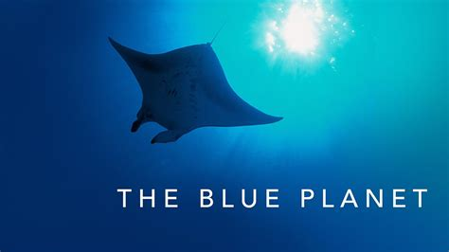
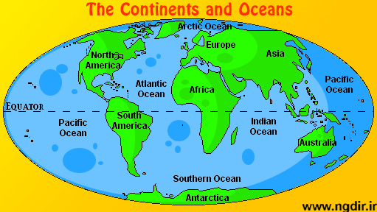
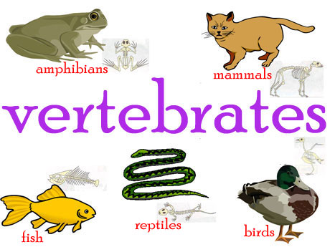
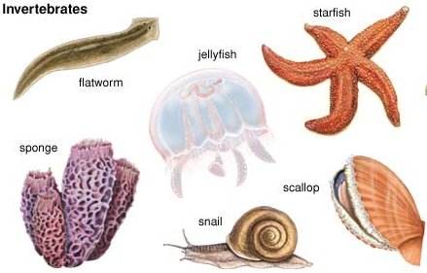
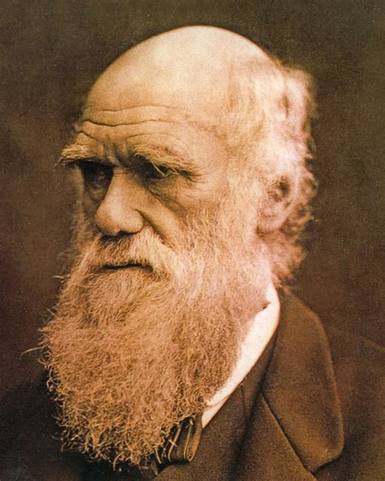
Key vocabulary
Volcano | An opening in the Earth’s crust that allows magma, ash and gas out. | Climate change | An increase in temperature that changes the Earth’s atmosphere.
Habitat | The natural environment of a living thing. | Physical geography | The study of the natural environment, such as rivers, vegetation and climates.
Classification | A way of placing things into different groups. | Vertebrate | Animals with a backbone – mammals, birds, fish, amphibians and reptiles.
Continent | A large area of land on the Earth. | Invertebrate | Animals without a backbone – worms, crabs, jellyfish and butterflies.
Ocean | A vast amount of water that covers the Earth. | Evolution | A process of growing and developing.
Year 4 Spring Term:
Charles Darwin:
A famous scientist and explorer.
He travelled around the world learning about different animals.
Darwin developed a theory of evolution and natural selection.

